Slide 1
aNTI-Corruption reforms and shareholder valuations: EVENT STUDY EVIDENCE FROM CHINA
By: Chen Lin, Randall Morck, Bernard Yeung, Xiaofeng Zhao
Presented by Zixuan(David) Wang

Slide 2
Agenda
Background and Event Description
Methodology
Data (Sample, Firm Type, Spending on Investment, and Market Development)
Empirical Findings
Robustness Discussion
Conclusion
My Opinion

Slide 3
Background and Event Description
Corruption in China
Dense networks of interpersonal obligations or guanxi (关系, lit. “ connections ” )
are a historically and culturally deep-rooted part of business in China.
Developing connections is a normal and respectable part of doing business, indeed of life – and not just in China but in many parts of Asia and the world.
However, guanxi can become excessive and turns into socially corrosive
corruption, which is an increasing concern in China in recent years.

Slide 4
Background and Event Description
Official corruption is of special importance in China because its Market Socialism system relies critically on virtuous government officials. The Leading Role of the Communist Party of China gives the Party policies constitutional precedence over all laws and regulations and empowers Party officials to intervene in judicial and regulatory decisions.
The vast discretionary powers officials wield can easily make establishing ties of guanxi with them a very high return investment to any nonSOE (State-Owned Enterprise) business enterprises.

Slide 5
Background and Event Description
In this environment, the innocuous building of human connections becomes an avenue for political rent-seeking, which Krueger (1974) models as firms investing in influencing government officials with the expectation of profiting from regulatory favors, tax breaks, subsidies, etc.
Chinese political rent-seeking uses guanxi to implant a sense of obligation by providing a government official with extravagantly expensive wining and dining, entertainment, travel, gifts,etc.

Slide 6
Background and Event Description
Widespread corruption can form a stable suboptimal political-economy equilibrium. If favor-trading between politicians and firms has been extensive, officials do not support anti-corruption reforms.
Powerful officials find anti-corruption reforms against their personal interests, even if they recognize the public good in such reforms.
A political shock to destabilize this equilibrium then becomes a necessary precursor to effective reforms.

Slide 7
Background and Event Description
Political background developments in 2012
The Hu Jintao-Wen Jaibao administration’s predetermined term ended in 2012, and the new administration of Xi Jinping assumed office amid an ongoing struggle between multiple Party factions for political power and economic gain.

Slide 9
Background and Event Description
The Eight-point Policy
Xi made cutting corruption his signature policy. Xi fired the first shot in the anti-corruption campaign on Dec 4th 2012. This was a policy document by the Politburo of the Central Committee of the CPC entitled the Eight-point Policy (八项规定).
Each of its points is an explicit instruction about how leading cadres are to behave going forward.

Slide 10
Background and Event Description
The eight points are:
1. Leaders must keep in close contact with the grassroots, but without inspection tours or
formality.
2. Meetings and major events are to be strictly regulated and efficiently arranged; empty
grand gestures are to be avoided.
3. The issuance of official documents must be reduced.
4. Overseas official visits and related formalities are to be restricted.
5. Leaders traveling by car must avoid disrupting traffic.
6. Media stories about official events are to be limited to events with real news value.
7. Government leaders should not publish self-authored works or congratulatory letters.
8. Leaders must practice thrift and strictly obey regulations regarding accommodation and
cars.

Slide 11
Background and Event Description
The Eight-Point Policy’s purpose was explicitly spelled out: it signaled a general condemnation of government officials trading favors.
The Eight-point Policy was the only major national news story on or around Dec 4th 2012.
The policy gained immediate and widespread attention.

Slide 12
Daily Baidu Internet Search Volume
The figure shows both search volumes rising sharply on Tuesday, December 4th, the event date,
with “Eight-point Policy” searches peaking two days later (Thursday December 6th) and “anticorruption
searches” peaking three days later (Friday December 7th).

Slide 13
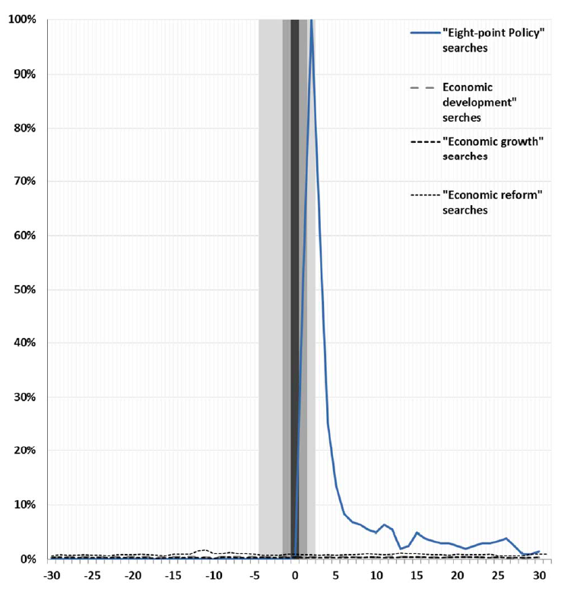
Daily Baidu Internet Search Volume
The figure affirm the absence of other news related economic policy changes in or near the event windows.(Friday December 7th).

Slide 14
Background and Event Description
Event Study
The event date corresponds to no other confounding major news release of potentially economically important. Stock returns around the event therefore plausibly reflect investors’ initial expectations as to whether the policy announcement signaled a new administration firmly in charge and launching a substantive reform (with differential impact across the economy) or merely an abruptly fiercer inter-factional power struggle within the Party.
This period of relative market calm is also favorable to searching for information-driven share price movements in China’s markets.

Slide 15
Methodology
Modified Event Study Methodology
The Eight-point Policy was designed to affect the entire economy, not specific firms, and to affect all firms at once. This motivates our first examining the market portfolio’s raw return on and around the event date, instead of subtracting it to form abnormal returns.

Slide 16
Methodology
Second, we expect different sorts of firms in different parts of the country to be differently affected by the Eight-point Policy. We investigate this by comparing the returns of portfolios of firms based in different provinces or with different characteristics. These exercises use the tests Schwert (1981) recommends for event studies of regulatory changes.

Slide 17
Methodology
Finally, we explore heterogeneity in the reactions of different sorts of firms to the
announcement by running regressions explaining either firm-level cumulative raw
returns or firm level cumulative abnormal returns. These regressions assume a
meaningful degree of independence in the idiosyncratic components of individual
firms’ reactions to the Eight-point Policy.
To mitigate overstating statistical significance, we cluster standard errors both by industry and by province.

Slide 18
Data
Sample
Our sample is all firms listed on China’s two stock exchanges – the Shanghai Stock Exchange and the Shenzhen Stock Exchange. Stock returns and financial data are from the CSMAR database.
We drop all firms with material corporate events, such as stock or cash dividends, stock splits or reverse-splits, new share issuances, or M&A announcements, in the five-day event window surrounding the Dec. 4th 2012 event date.
In looking at how different stocks might react differently to the Eight Point Policy announcement, we consider firm types – SOEs versus nonSOEs, their likely past investment in official connections, and the institutional environment in which they reside.

Slide 19
Data
Firm Type: SOEs and nonSOEs
China has two broadly defined classes of listed firms, state-owned enterprises (SOEs) and nonstate-owned firms (nonSOEs).
SOE top managers are career-minded bureaucrats, usually assigned to an SOE for only a few years before being moved on. Their promotion prospects depending on faithfully implementing Party directives.
SOEs appear to enjoy favorable official treatment. For example, SOEs have preferential access to bank loans, the dominant form of financing in China. SOEs often have state-enforced monopoles in key sectors including natural resources, civil aviation, communications, and finance.

Slide 20
Data
NonSOE top executives, in contrast to those of SOEs, often have substantial equity ownership stakes, and their careers are more tied to their firms’ prospects.
NonSOEs are not intrinsically connected to the civil service, and have less access to state owned bank loans, capital markets (e.g. IPO) and official licenses to enter new lines of business.
NonSOEs must contend with more severe bureaucratic obstacles than SOEs confront.

Slide 21
Data
If genuine anti-corruption reforms mitigated officials’ discretionary powers, more competitive firms would obtain more financing and business opportunities; and this could encourage nonSOEs more than SOEs.
In contrast, if it leads to bureaucratic paralysis and increasing the cost of doing business, nonSOEs could be worse affected than SOEs.

Slide 22
Data (Firm type Classification)
State control over listed firms is sometimes exercised through control chains of
intermediate firms.
We make an indicator variable that flags state-owned enterprises (SOEs), by which we mean firms controlled by the state or state organs at or above the 30% threshold, either directly or indirectly via equity control chains whose weakest link is 30% or higher.

Slide 23
Data
Investment in Connection
Prior work suggests that reducing corruption diminishes the value of a firm’s political connections (Fisman (2001)). Different firms may have invested different amounts in connections. A binding anti-corruption reform that reduces the importance of such connections might adversely affect firms with substantial such investments, even as it lifts the burden of corruption from the economy as a whole.
Cai et al. (2011) show that firm-level “entertainment & travel costs” from the WIND database proxy for firms’ investment in connections.

Slide 24
Data
However, ETC also includes executives spending on their own entertainment and travel. We therefore allow that ETC might reflect either investment in connections or private benefits.
We speculate that the insider private benefits component of ETC is likely higher in SOEs than in nonSOEs. If the Eight-point Policy mitigates private benefits, SOE shareholders would then gain more than nonSOE shareholders.

Slide 25
Data
Development of Market Institutions
Market reforms have progressed to very different stages in different provinces. Where market institutions are better developed, reducing corruption plausibly improves resource allocation efficiency more.
Where market institutions are less developed, official connections might be essential to “grease” bureaucratic gears, and reducing corruption might have ambiguous implications.

Slide 26
Data
To measure the stage of market reforms, we use the province-level Marketization Index produced by the National Economic Research Institute (NERI) (Fan et al., 2011).
The Marketization Index, based on official statistics and enterprise and household surveys, ranges from zero to ten in the base year 2001, with higher scores indicating more progress towards a market economy, and can exceed ten or fall below zero in subsequent years to reflect a province’s progress or retrogression over time.

Slide 27
Data
NERI Subindexes
1) Resource Allocation Subindex
Measures the extent to which the market, rather than government, allocates resource using the government’s budget as a fraction of GDP.
The index is coded as such that a higher value indicates a larger role for market forces.
2) Financial Sector Marketization Subindex
Gauges nonSOEs’ access to capital based on deposits in nonSOE financial institutions and all (mostly SOE) banks’ lending to nonSOEs.
3) Legal Environment Subindex
Uses enterprise survey data to assess the legal environment each province provides for businesses.

Slide 29
Empirical Findings
The Reaction of the Market
Province-Level Portfolio Cumulative Returns
Market Development, State Control, and Prior Investment in Connections
Firm-level Regressions
Change in Firm Performance

Slide 31
The Reaction of the Market
These results are consistent with investors expecting firms located in provinces where market institutions are more developed to gain from reduced corruption, but expecting negligible net gains for firms in provinces where market institutions are less developed.

Slide 32
Empirical Findings
Province-Level Portfolio Cumulative Returns
A multivariate regression analysis explores the relationship between stock price reactions and province characteristics in greater details. We construct portfolios of firms domiciled in each province and regress these portfolios’ event window cumulative returns on province characteristics including GDP Growth, Education Expenditure/GDP, Marketization and Log (GDP per capita).
GDP growth proxies for growth trajectory; Education expenditure/GDP captures human capital stock; and Marketization and Log (GDP per capita) capture the development of market institutions and the level of economic development.

Slide 34
Province-Level Portfolio Cumulative Returns
Overall, these findings are consistent with reductions in corruption being more advantageous to firms in provinces with faster GDP growth, larger stocks of human capital, and more developed market institutions.
These characteristics plausibly identify provinces where firms can more readily take advantage of productivity-enhancing growth opportunities, once currying favor with officials is less necessary.
In contrast, restricting corruption appears less helpful to firms located in provinces where market forces are weaker, leaving “connections” more essential for “greasing” bureaucratic gears to “get things done”.

Slide 36
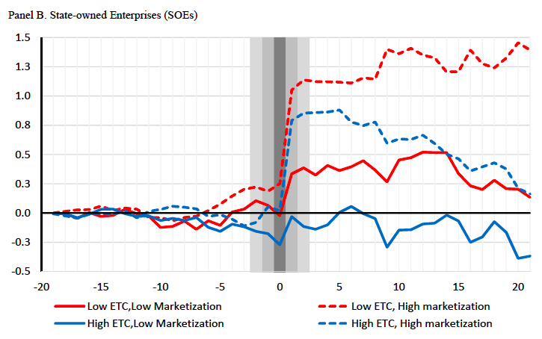

Slide 37
market DEVELOPMENT, STATE CONTROL, AND PRIOR INVESTMENT IN CONNECTION
The reform fails to lift the shares of any portfolio of nonSOE is consistent with “greasing bureaucratic gears” being more valuable to those firms, except in high-Marketization provinces.
The reform lifts SOE shares across the board is consistent with shareholders viewing their ETC as predominantly value-decreasing – that is, as spending on private benefits rather than valuable connection-building.

Slide 38
Empirical Findings
Firm-level Regressions
The regressions explore allocative efficiency by explaining stock price reactions to the policy announcement with additional variables that proxy for a firm’s competitiveness and external financing needs. We might expect proxies for competitiveness to correlate more positively with stock price reactions for firms based in provinces with more marketized institutions.
The regressions further explore the Marketization findings by using its more nuanced subindexes to track specific kinds of market reforms and their interactions with ETC.

Slide 39
Firm-level regression
The specific province-level business environment variables used include: provincial GDP Growth, Log(GDP per capita), Education Spending as a fraction of GDP, and the Marketization index or subindexes.
The firm characteristics include: Firm Size, taken as the log of total assets; Leverage (liabilities/total assets), and Research and Development Spending (R&D/ sales).
These regressions also include industry fixed-effects to remove common reactions across industries and always cluster residuals both by industry and by province.
Given the very different patterns of results for portfolios of SOEs and nonSOEs revealed in Table V, we run separate regressions for the two categories of firms.

Slide 40
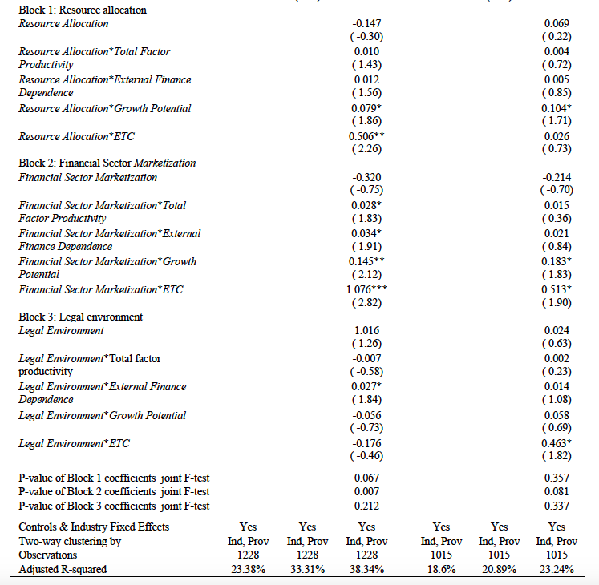

Slide 42
EMPIRICAL FINDINGS
Market machinery vs Legal Environment
Additional tests dig deeper by using Marketization sub-indexes that gauge the development of different sorts of market institutions.
We are interested in which facet of Marketization drives the results in columns 2 and 5.
We replace the interactions of Marketization with firm characteristics with three blocks of cross terms: firm characteristics interacted with Resource Allocation, with Financial Sector Marketization, and with Legal Environment.
Columns 3 and 6 report the regression results for the nonSOE sample and the SOE sample, respectively.

Slide 44
EMPIRICAL FINDINGS
Change in Firm Performance
The above tests all focus on shareholders’ expectations. This section explores how firm performance measures change around the introduction of the Eight-point Policy. One such measure is changes in firm valuation, measured as its daily market-to-book ratio averaged over the year after the passage of the policy (2013) minus the same average over the year before (2012). This is essentially the change in its Tobin’s Q, and we denote this ΔQ.
We also use the firm’s return on assets in 2013 minus its return on assets in 2012, denoted ΔROA, and its sales growth in 2013 minus its sales growth in 2012, ΔSG, to measure change in operating performance.
The data used to construct ΔROA and ΔSG are adjusted for differential inflation using provincial level CPI indexes with 2010 as base year from the PRC National Bureau of Statistics.

Slide 45
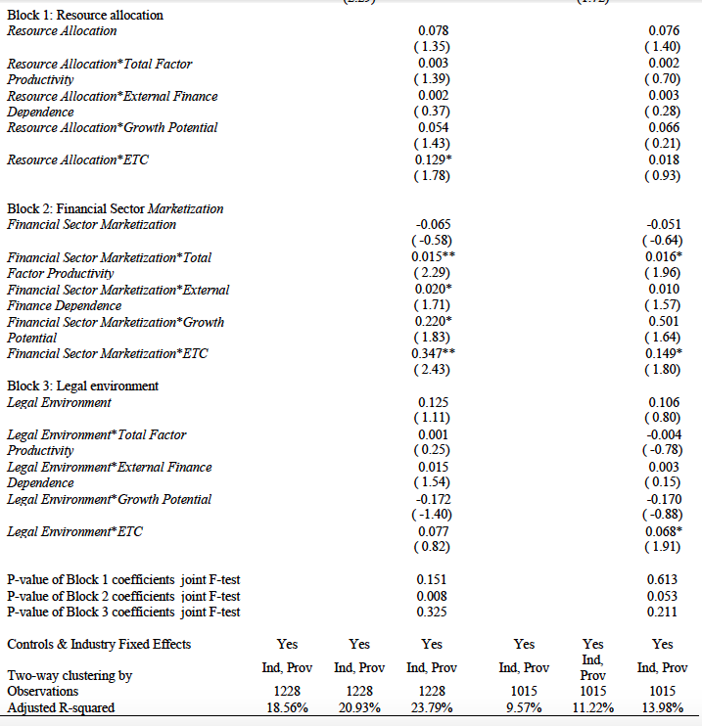

Slide 48
Robustness discussion
Statistical Robustness
Where a robustness check generates a pattern of signs and statistical significance identical to that in the tables, and point estimates roughly concordant to those in the tables, we say qualitatively similar results ensue. Where qualitatively similar results do not ensue, we explain the discrepancies in detail.
Robustness of Interpretation
This section examines two plausible concerns about the economic interpretation of our findings. Each examination describes additional tests that weigh in favor of the interpretation we propose and against the plausible alternatives.

Slide 49
Conclusion
Official corruption is of special importance in China because its Market Socialism system relies critically on virtuous government officials.
Our findings show that the Eight-point Policy is a genuine anticorruption drive.
Listed firms’ market valuations rose broadly and significantly around this event, consistent with markets expecting the reforms to be meaningful, rather than propaganda, as well as beneficial on net to public shareholders.

Slide 50
Conclusion
Some stocks gained markedly more than others around this event, and these patterns illuminate the economics of corruption. The key additional results are:
1. Listed SOEs’ shares gained more than nonSOEs’ shares.
2. Firms located in provinces whose market reforms were more advanced gained more.
3. More competitive firms, more external finance-dependent firms, and less connected firms all gain more if the firms are located in provinces with more advanced market reforms.These differences are also more pronounced for nonSOEs than for SOEs.
4. The stocks of nonSOEs in less reformed provinces gain less if they had reported higher entertainment and travel costs (ETC).

Slide 51
My Opinion
Nice try to understand the market reaction to the anticorruption statement
Concerns
Assumptions (Arbitrary threshold differentiate SOE & non-SOE, Speculations)
Validity of the original data & Pooling data from different datasets
Evaluate the market reaction to the “Eight-Point Policy” in longer term (One year) <1> Many economic implications of an effective anti-corruption policy may not appear the next year
<2> Noise when evaluating firm performance over longer period

Slide 52
THANK YOU!

